Slide 1



Strengthening deflation implementation for large scale LQCD inversions
PetaQCD
Claude Tadonki
Mines ParisTech / LAL-CNRS-IN2P3
Review Meeting / PetaQCD
LAL / Paris-Sud University, September 27-28, 2012

Slide 2



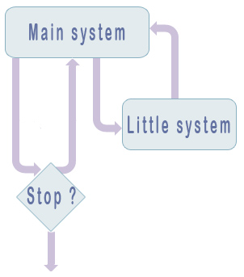

Strengthening deflation implementation for large scale LQCD inversions
Claude Tadonki
PRELIMINARY REMARKS
We are involved with (very) large-scale linear systems with an implicit principal matrix.
Because of the implicit form of the Dirac matrix, we only use iterative methods.
For some parameters (e.g. light masses), the Dirac matrix has a poor condition number.
One way to tackle ill-conditioned cases is to use the so-called deflation method.
The deflation method attempts to « isolate » the low modes space.
The deflation method is a two stages iterative method.
In order to be efficient, both from the qualitative and the quantitative point of view, the deflation method needs a good calibration and lot of programming efforts.
Review Meeting / PetaQCD
LAL / Paris-Sud University, September 27-28, 2012

Slide 3
Strengthening deflation implementation for large scale LQCD inversions
Claude Tadonki
TECHNICAL OBSERVATIONS
The need to approximate the (nearly) kernel subspace.
Our approximation of the low modes space concerns both the dimension and the basis.
An (over/under)dimensioned approximation will lead to degrade the global performance.
The quality of the «low» eigenvectors approximations is also concerned (although the
common belief that this is not important) .
The second stage subsystem is also solved iteratively.
The number of iterations of global system and that of the inner system are correlated.
With large gauge configurations and low masses, we have a huge number of iterations and each iteration is costly, thus we are facing a large-scale computation problem.
Review Meeting / PetaQCD
LAL / Paris-Sud University, September 27-28, 2012

Slide 4


Strengthening deflation implementation for large scale LQCD inversions
Claude Tadonki
APPROXIMATION OF THE LOW MODES SUBSPACE (also called DEFLATION SUBSPACE)
The dimension of the deflation subspace is given as a user parameter (N_{s}).
The computation of the deflation subspace basis (i.e. N_{s} approximated eigenvectors) is severely costly.
We choose to compute each of the N_{s} vectors by targeting a real eigenvector (heavy).
It is expected that the more the deflation subspace is accurate the shorter will be the path to the solution of the global system. This is true in theory, but the reality is versatile.
One argument commonly admitted to pay the price for a good deflation subspace is that this will serve for several inversions.
Since our system is large, we need a way to extend the deflation basis at a reasonable cost.
We choose to extend the deflation subspace by means of canonical block projections.
Review Meeting / PetaQCD
LAL / Paris-Sud University, September 27-28, 2012

Slide 5
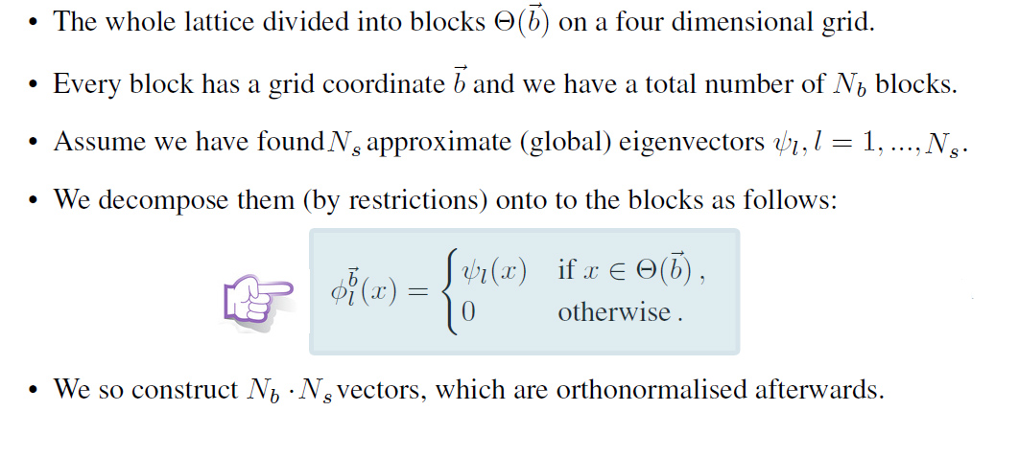
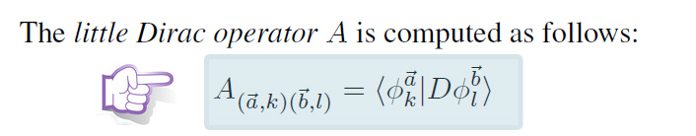
Strengthening deflation implementation for large scale LQCD inversions
Claude Tadonki
BLOCK DECOMPOSITION AND THE LITTLE DIRAC
Review Meeting / PetaQCD
LAL / Paris-Sud University, September 27-28, 2012

Slide 6
Strengthening deflation implementation for large scale LQCD inversions
Claude Tadonki
TECHNICAL REMARKS ABOUT BLOCK DECOMPOSITION
Initial status of the block decomposition
It was performed only on the z axis (i.e. b = (0, 0, 0, k) ).
The number of blocks was fixed (and hard coded) to 2.
Blocks parameters apply on one computing node, so the total number of blocks is
proportional to the number of processors.
The consequences of the two previous statements are
We cannot increase the number of blocks as desired, unless we use more processors.
More processors means more the number of blocks, which is not necessarily wanted.
We are missing other decomposition possibilities.
We need a generic block decomposition, means multidimensional and with no restriction on the number of blocks per axis.
Review Meeting / PetaQCD
LAL / Paris-Sud University, September 27-28, 2012

Slide 7
Strengthening deflation implementation for large scale LQCD inversions
Claude Tadonki
OUR WORK ON THE BLOCK DECOMPOSITION
We have implemented a generic block decomposition (multidimensional and with no restriction on the number of blocks per axis) within the tmLQCD package.
For this purpose, we adapted the following modules
The input parameters list and associated I/O routines.
The initialization routines.
The extension of the initial pseudo-eigenvectors using block decomposition.
The preparation of the little Dirac components.
The checking routines (to make sure we have good projectors).
The computation of the little Dirac and its product by a vector.
MPI communication according to the decomposition.
Mechanism to store (and later read) the generated intial pseudo-eigenvectors.
Review Meeting / PetaQCD
LAL / Paris-Sud University, September 27-28, 2012

Slide 8
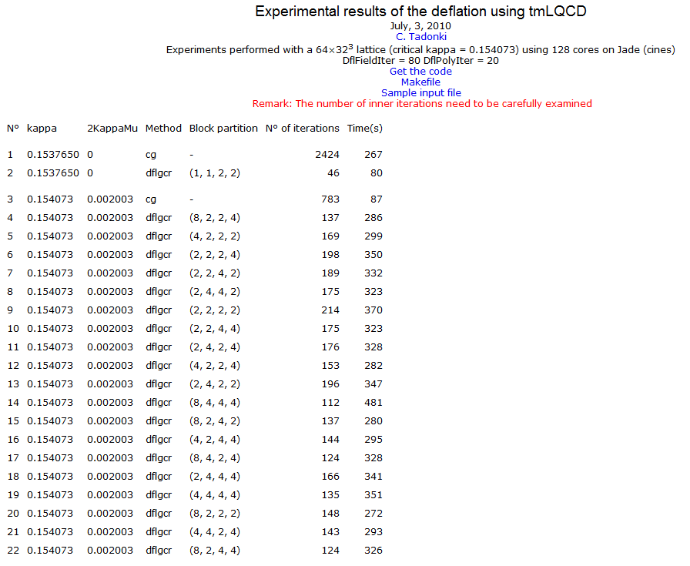
Strengthening deflation implementation for large scale LQCD inversions
Claude Tadonki
EXPERIMENTAL RESULTS
Review Meeting / PetaQCD
LAL / Paris-Sud University, September 27-28, 2012

Slide 9
Strengthening deflation implementation for large scale LQCD inversions
Claude Tadonki
PERSPECTIVES
We think about the following perspectives
Having a block decomposition not correlated with the number of computing nodes.
Try other forms of decomposition (not necessarily canonical projections).
Consider direct approaches for solving the little Dirac, since it is a constant matrix.
Try a factorization approach for the little Dirac (LU for instance).
Study the possibility for a dynamical reconfiguration of the deflation parameters.
Extend the timing (and memory) profile report to include the part from the deflation.
Examine carefully the memory footprint of the deflation part.
Se what we can really do for the deflation subspace generation.
Review Meeting / PetaQCD
LAL / Paris-Sud University, September 27-28, 2012

Slide 10


Strengthening deflation implementation for large scale LQCD inversions
Claude Tadonki
?
Review Meeting / PetaQCD
LAL / Paris-Sud University, September 27-28, 2012

